Slide 1

Concord + VMWorld customer Relations/Tracking with vSWAG
Blockchain hackathon
Team Blockchain
http://13.59.98.146:8080/dashboard
https://github.com/nillocftw/vmware2018

Slide 2
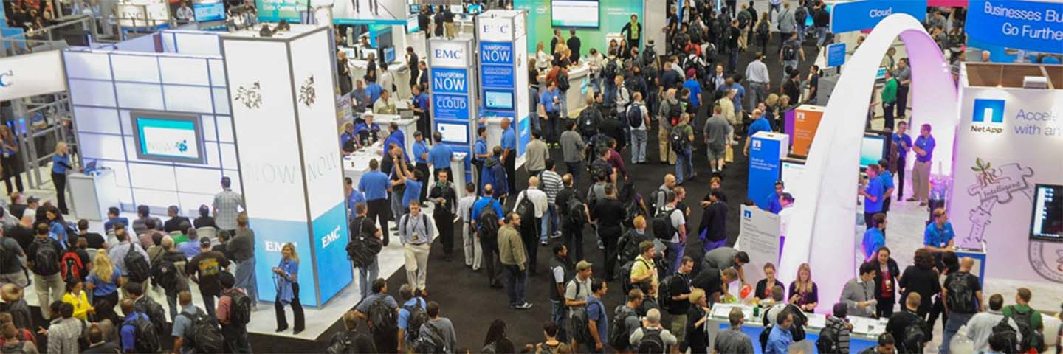
Tracking People + Vendors + Interactions
Vender/Participant interactions are tracked on the ledger
Participant interactions are tracked and logged onto blockchain
Once a vendor hits 100 interactions, the Smart Contract releases the ‘vSwag’ currency
Allows vendor to find user’s contact info based on their unique badge/wallet ID

Slide 3

END USER EXPERIENCE
Conference attendees can collect vSwag tokens from Vendors by participating marketing events and sales campaigns.
Attendees can redeem vSwag tokens in VMware store or Vendor booth for swag items.
Vendors will contribute vSwag tokens to be redeemed for goods.

Slide 4
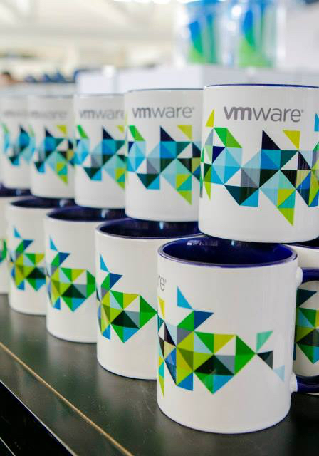
Why blockchain?
vSWAG
Track participants and vendors are tracked
Every individual has a verified identity ‘wallet’
Ability to check what individuals worked with what person
Or
What vendor to what people

Slide 5
TRY IT!
http://13.59.98.146:8080/dashboard
https://github.com/nillocftw/vmware2018

